Slide 1
Tomato Leaf Disease Prediction Using Deep Learning and Gradio
By
Aalisha Ilahi Patwekar [24047]
Under the Guidance of
Prof.S.B.Thorat

Slide 2
Introduction
Tomato Leaf Disease Prediction using Deep Learning & Gradio
Built a CNN-based model to classify tomato leaf diseases
Collected, preprocessed & augmented dataset for better generalization
Trained & fine-tuned model using TensorFlow/Keras with dropout & callbacks
Evaluated performance using accuracy, precision, recall, F1-score & confusion matrix
Deployed model with Gradio for real-time disease prediction from uploaded images
Gained end-to-end experience: data → model → evaluation → deployment

Slide 3
Significance and Rationale
Bridged theory and practice through Tomato Leaf Disease Prediction using CNN & Gradio.
Strengthened academic concepts (CNNs, training, evaluation, preprocessing).
Gained hands-on skills in Python, TensorFlow, Keras, and Gradio deployment.
Built end-to-end AI pipeline: data prep → model training/fine-tuning → evaluation → deployment.
Project impact: scalable disease detection, supports agritech, improves farming outcomes.
Internship shaped career focus and enhanced both technical & professional skills.

Slide 4
Implementation
Data collection
Training
Prediction
Evaluation

Slide 5
Internship Work Details
Project: Tomato Leaf Disease Prediction using CNN & Gradio
Built deep learning model to classify 10+ tomato leaf diseases
Preprocessed dataset (augmentation, normalization, train/val split)
Designed & trained CNN with TensorFlow/Keras; optimized with callbacks
Evaluated model using accuracy, F1-score, and confusion matrix
Deployed interactive Gradio web app for real-time predictions
Documented workflow in Jupyter Notebook & presented results
Outcome: Hands-on experience across the ML pipeline – from data prep to deployment

Slide 6
Learning Outcomes
Academic Knowledge – Strengthened ML/DL concepts, CNNs, transfer learning, and fine-tuning through real-world application.
Technical Skills – Hands-on with TensorFlow/Keras, hyperparameter tuning, optimization, and deployment (Gradio/Flask/Streamlit).
Data Handling – Improved dataset management, preprocessing, augmentation, and model evaluation with confusion matrices.
Communication – Enhanced documentation, clean coding, presentations, and visualization of results.
Career Readiness – Gained confidence in end-to-end ML pipelines, industry workflows, and applying AI in agriculture.
Personal Growth – Developed problem-solving, persistence, time management, and adaptability.

Slide 7
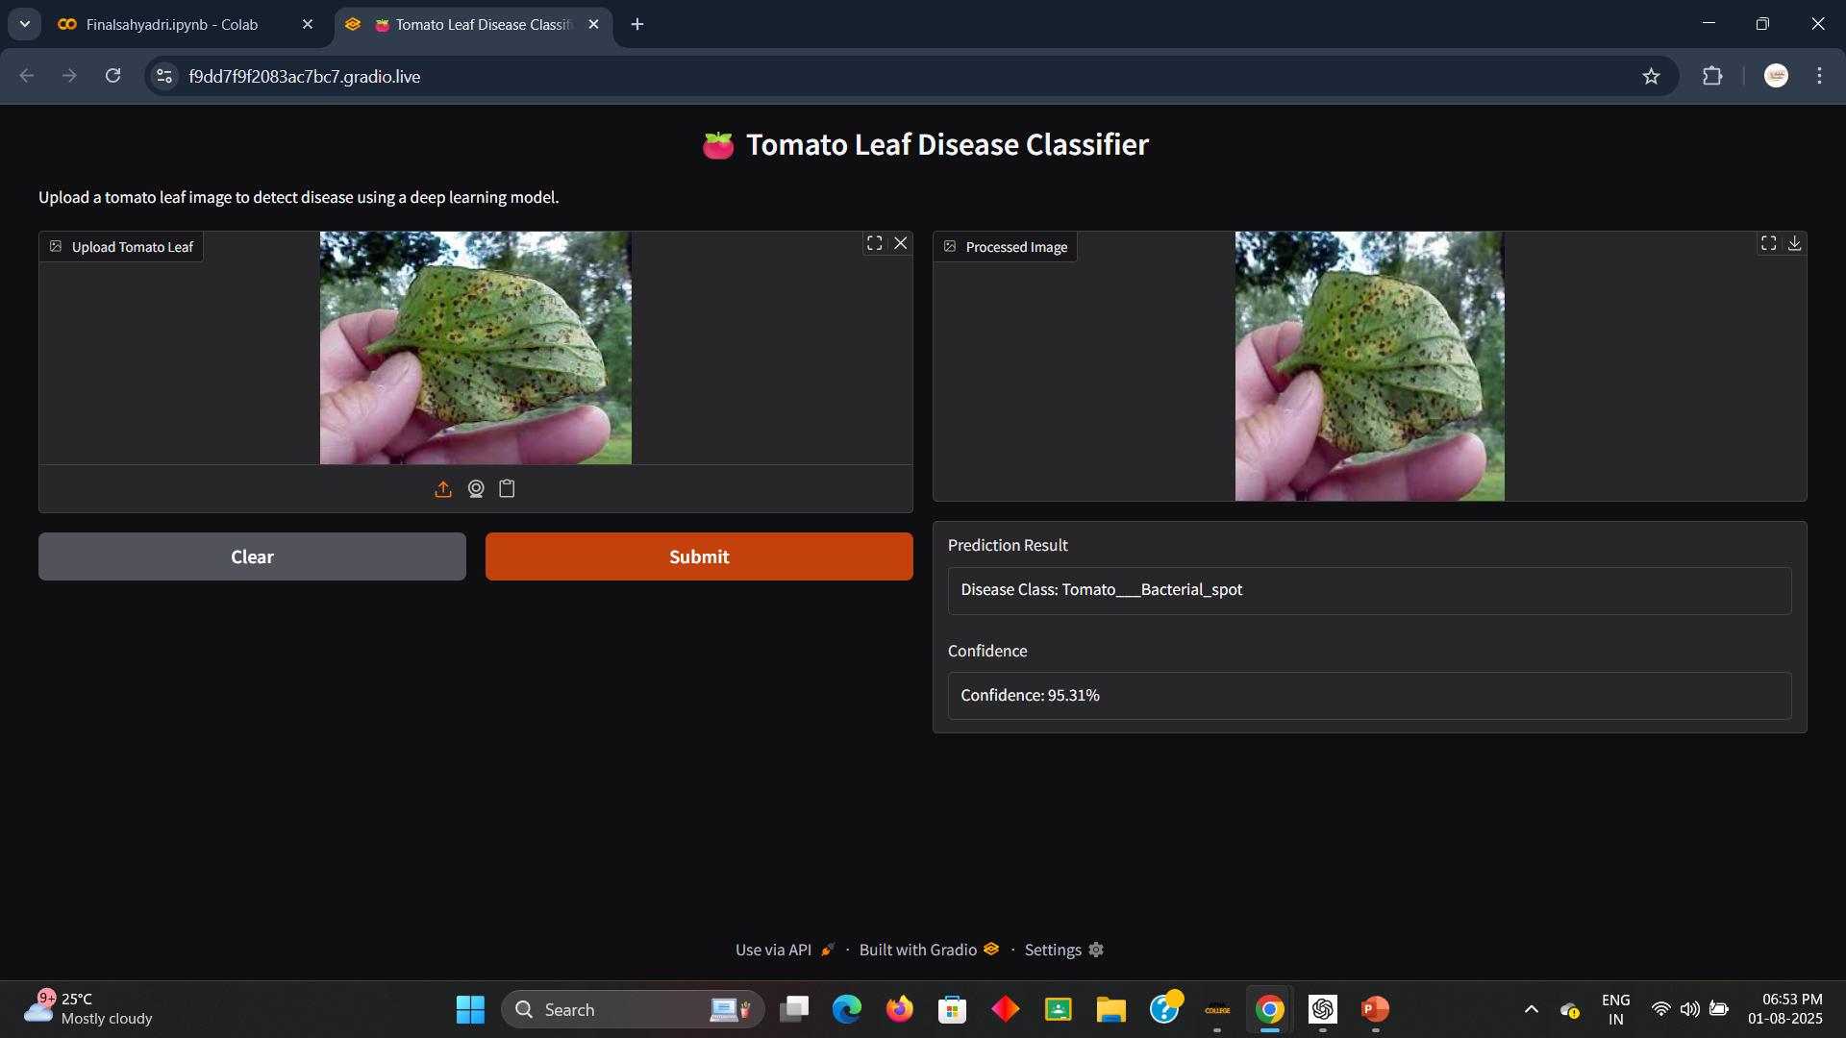
Interface on Laptop:

Slide 8
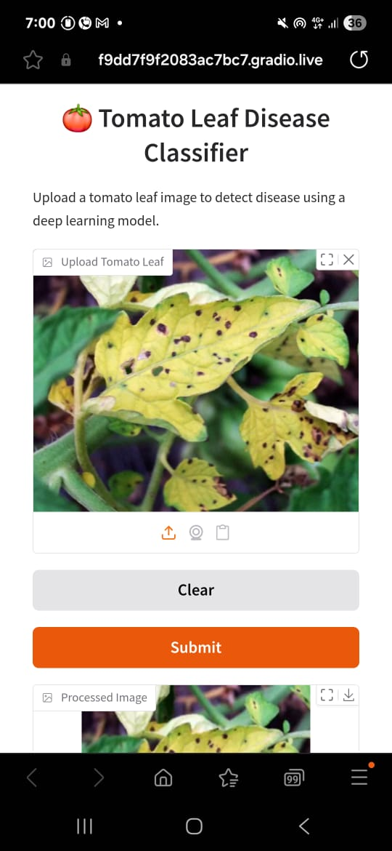
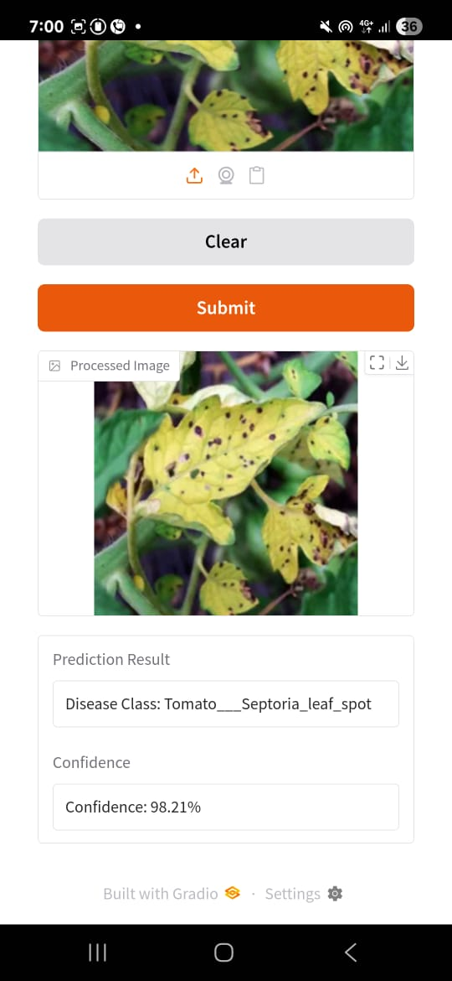
Interface on Mobile:

Slide 9
Conclusion
Developed an automated tomato leaf disease prediction system using CNNs.
Achieved high performance (accuracy, precision, recall, F1-score, confusion matrix).
Gradio deployment enabled real-time, user-friendly predictions.
Demonstrated the role of AI in agriculture for early disease detection and improved crop management.

Slide 10
Thank You..

